Slide 1
Facebook Comment Prediction
B Dinesh Kumar

Slide 2
Business Problem
In this project, we will identify the dynamic behaviour of users towards a post shared on Facebook, we will try to understand how a user comments based on a post or how many comments a post can receive in a certain period.
We will do this to predict what type of posts receives the highest number of comments or reach. So that the advertisements can be promoted in those posts.

Slide 3
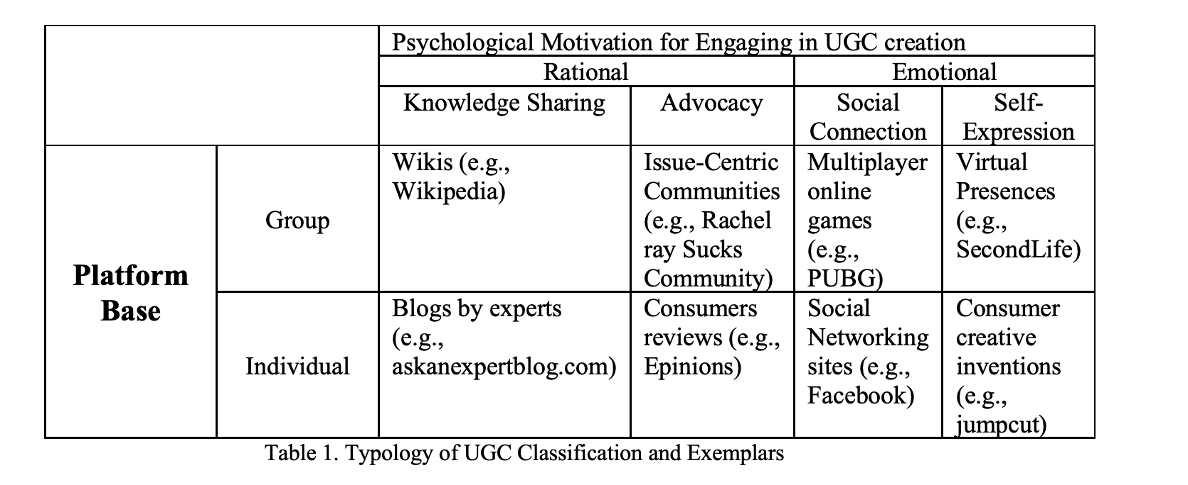
Business Problem
User generated content can be classified as below

Slide 4
Approaches Used
Linear Regression : As the target variable is a continuous variable
Lasso & Ridge Regression: To reduce model complexity
Boosting Using XGBoost: To improve model prediction by gradient boosting
PROBLEMS FACED:
Imbalanced Data
Unable to perfect the model as most of the data is left skewed

Slide 5
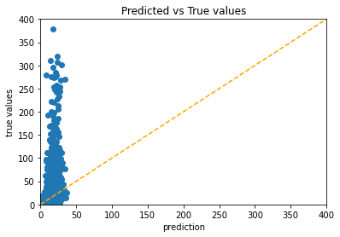
Approach Insights
XGBoost seems to perform better compared to other models
Since the data is heavily imbalanced its hard to predict
We can use SMOTE for Regression to solve the imbalanced data for the regression Problem
Most of the predicted values fall in the 0

Slide 6
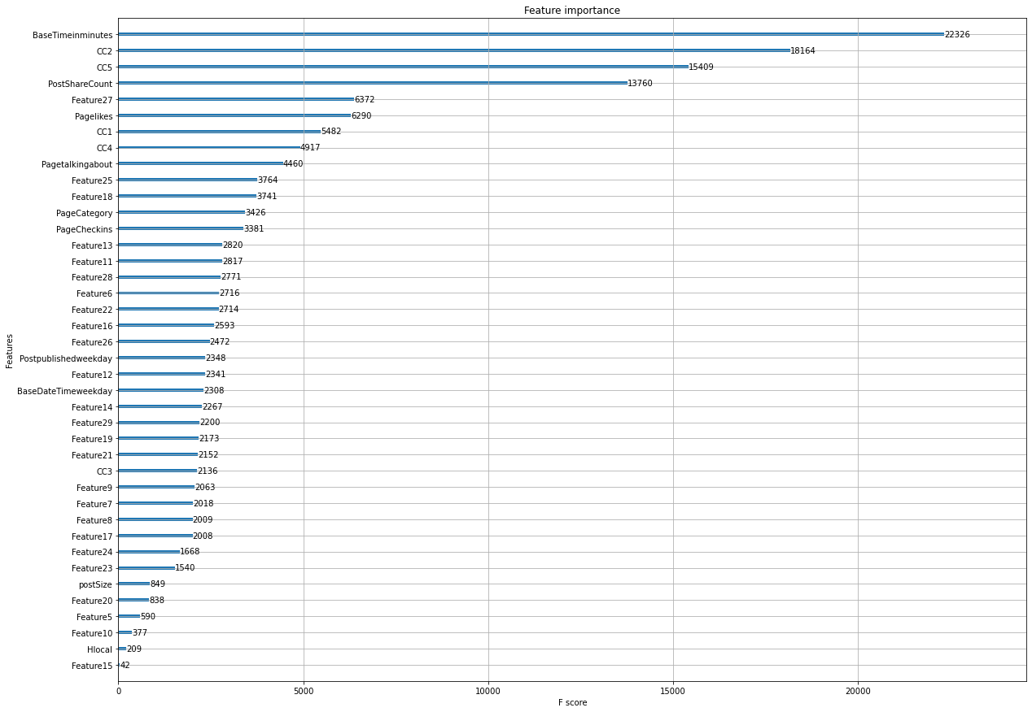
Insights from Analysis
The important features for the prediction are displayed in the figure
The top 5 variables which contribute to predictions are “Base Time”, “CC2”, “CC5”, “Post Share Count”, “Feature 27”.

Slide 7
Business Recommendation
The comments which the post received with in 48 hours determine the no of comments a post can have that is what is derived from CC2 and CC5 variables
The highest number of times the post is shared there is a high chance of getting more comments
The time in which the Content is posted also contributes for a greater number of comments.

Slide 8
Other Approaches
Since our data is heavily skewed towards 0. we can convert the Target Variable into a classification variable as 0-10 comments are low comments, 10-100 are medium comments and above 100 high comments
By doing so we can solve the imbalance easily with SMOTE and our model can perform better
Approaches tried are Logistic Regression where model performed at 98% confidence on both test and train data

Slide 9
Questions?

